Slide 1
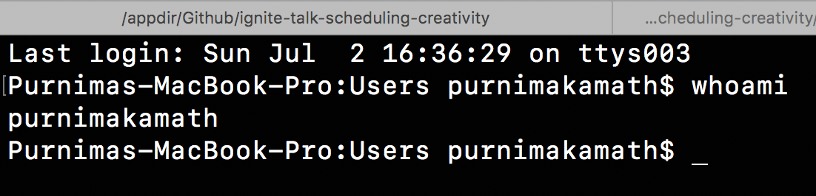

Client & Content
Technology

Slide 2
Not
really
my
topic
today
**But I really like to talk about it…

Slide 3
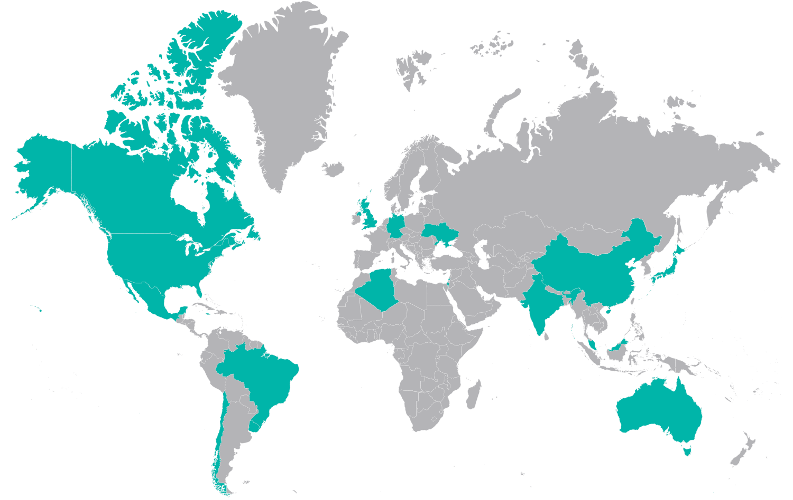
Globally -
67 Cities
20 Countries
80,000++ members
Launched
in
January!

Slide 4
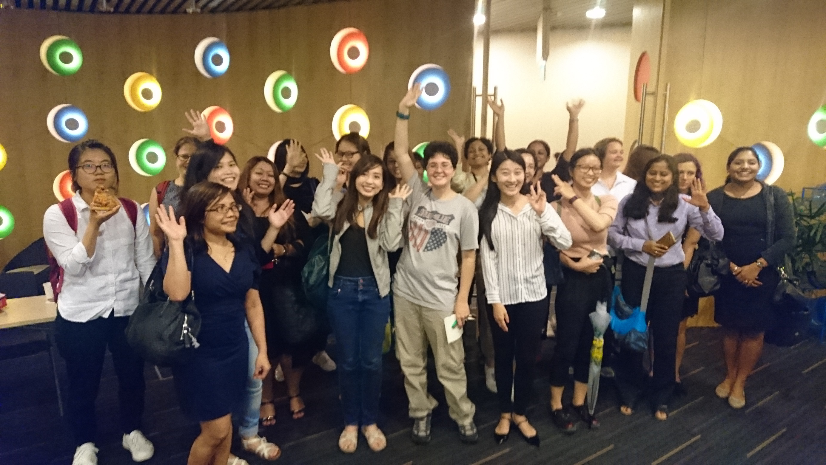
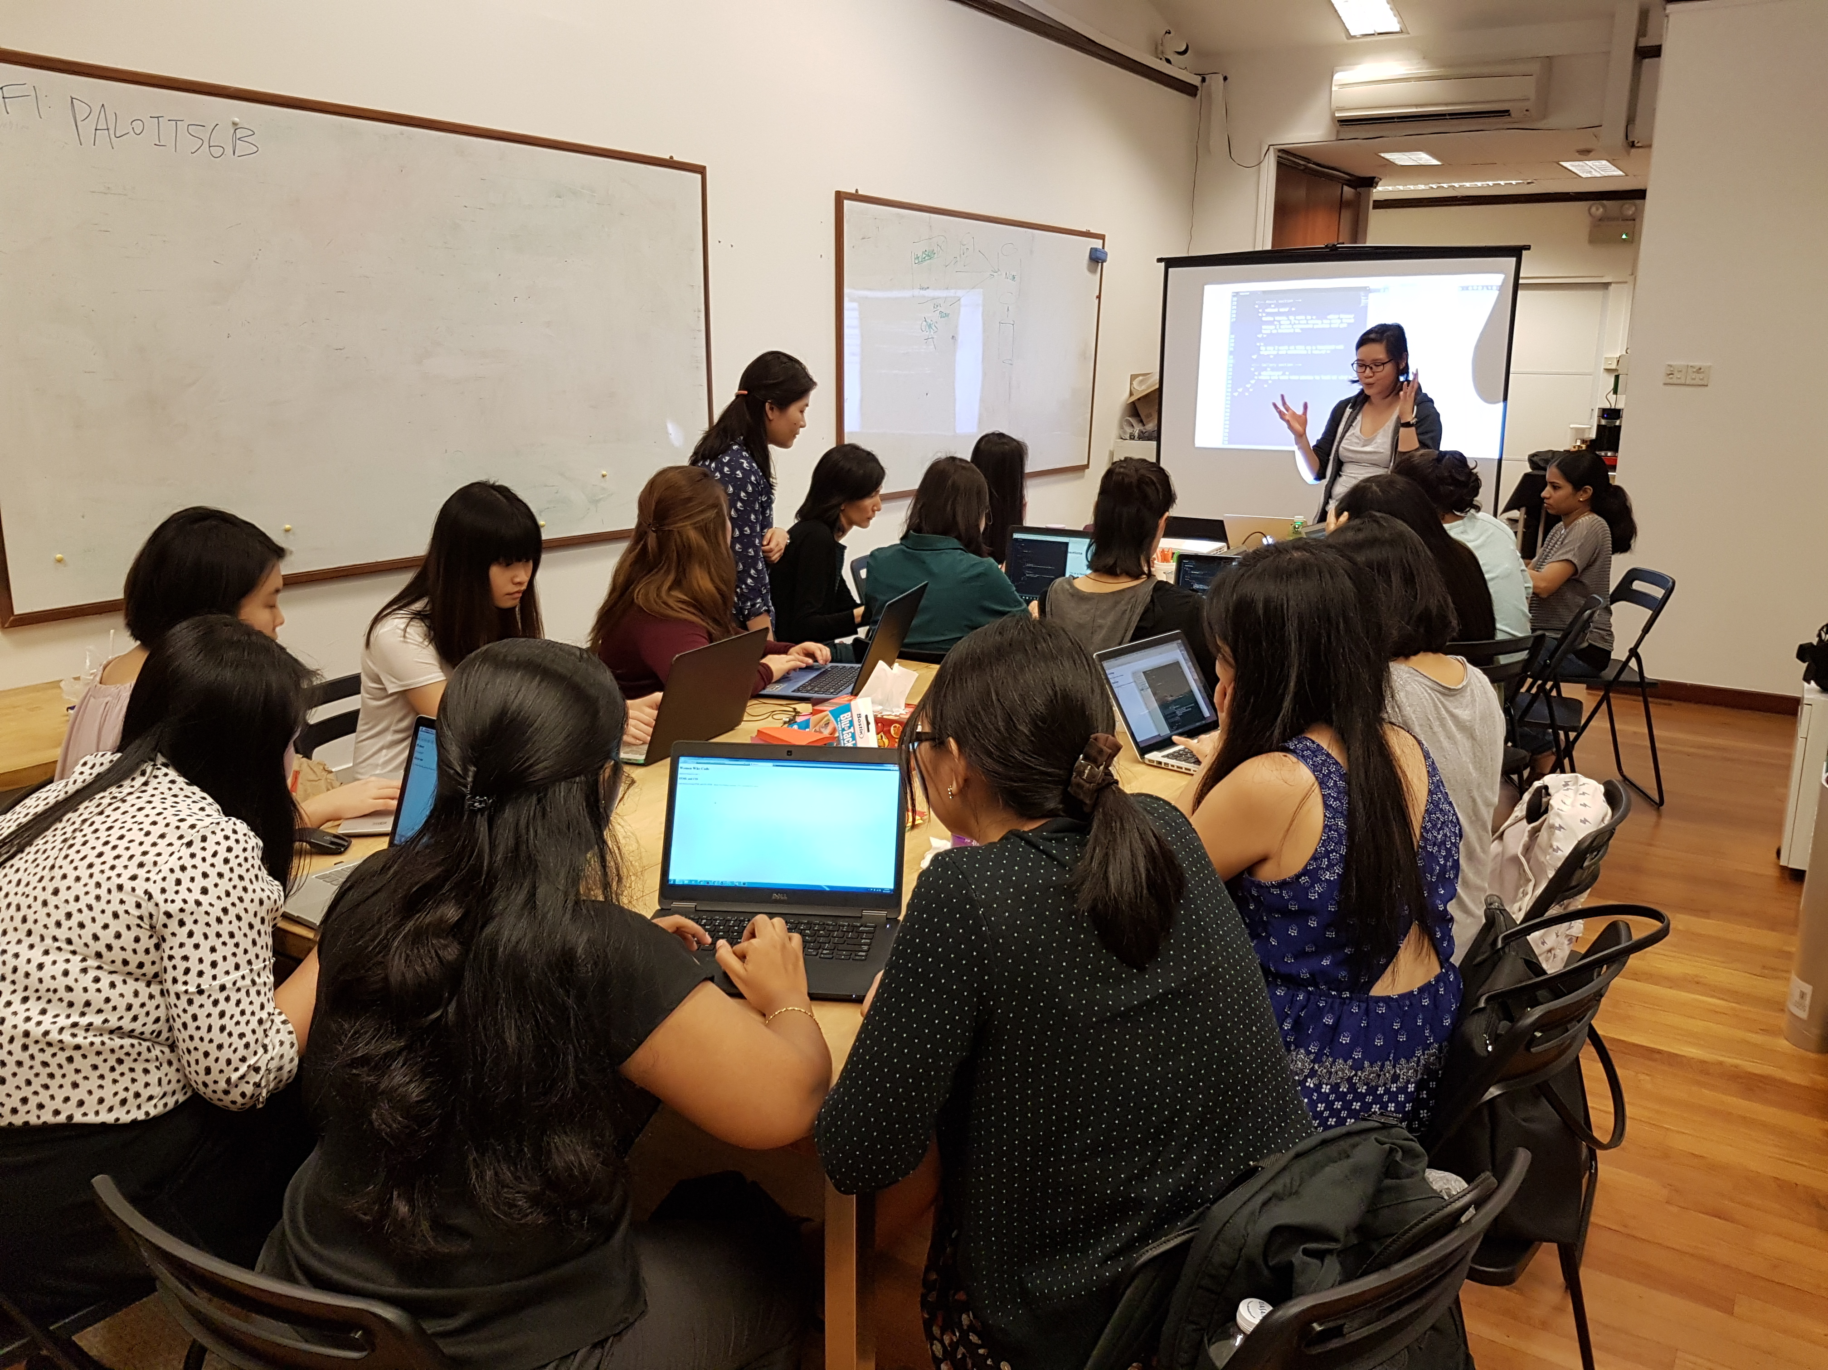
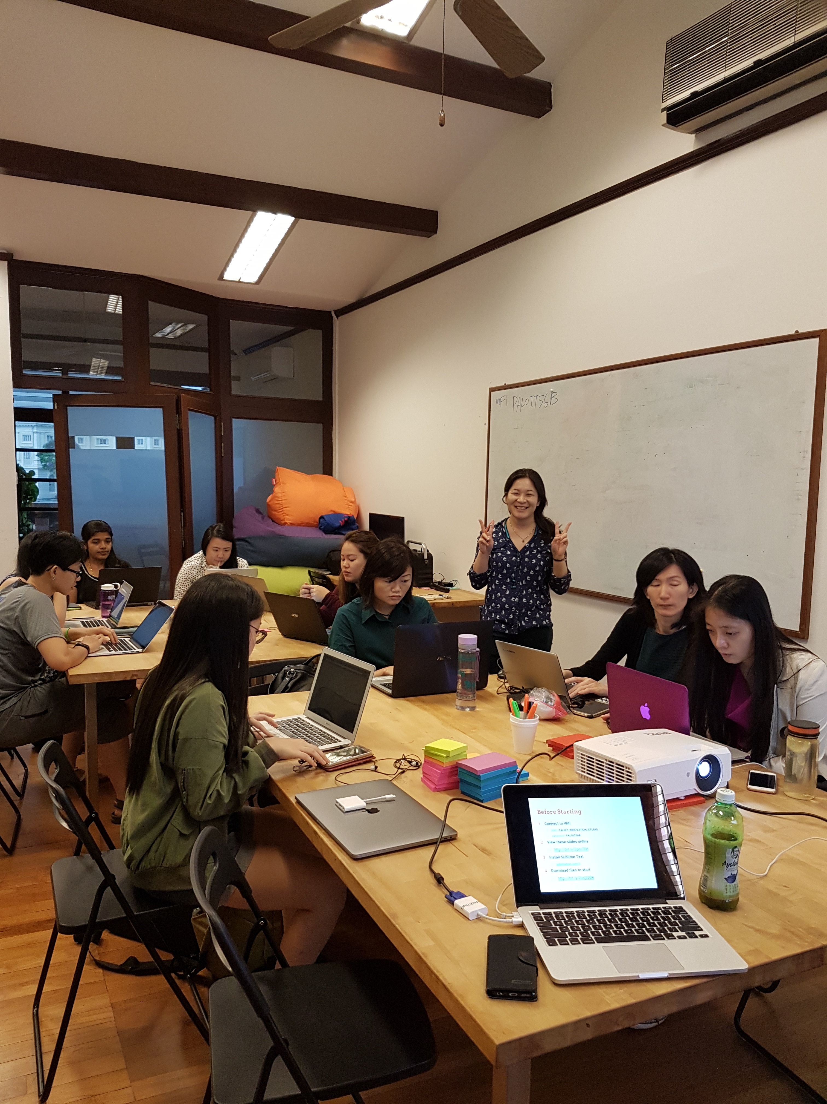
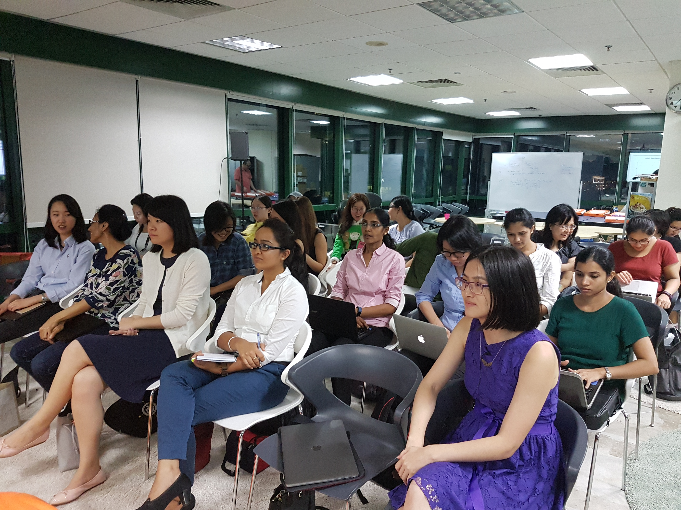
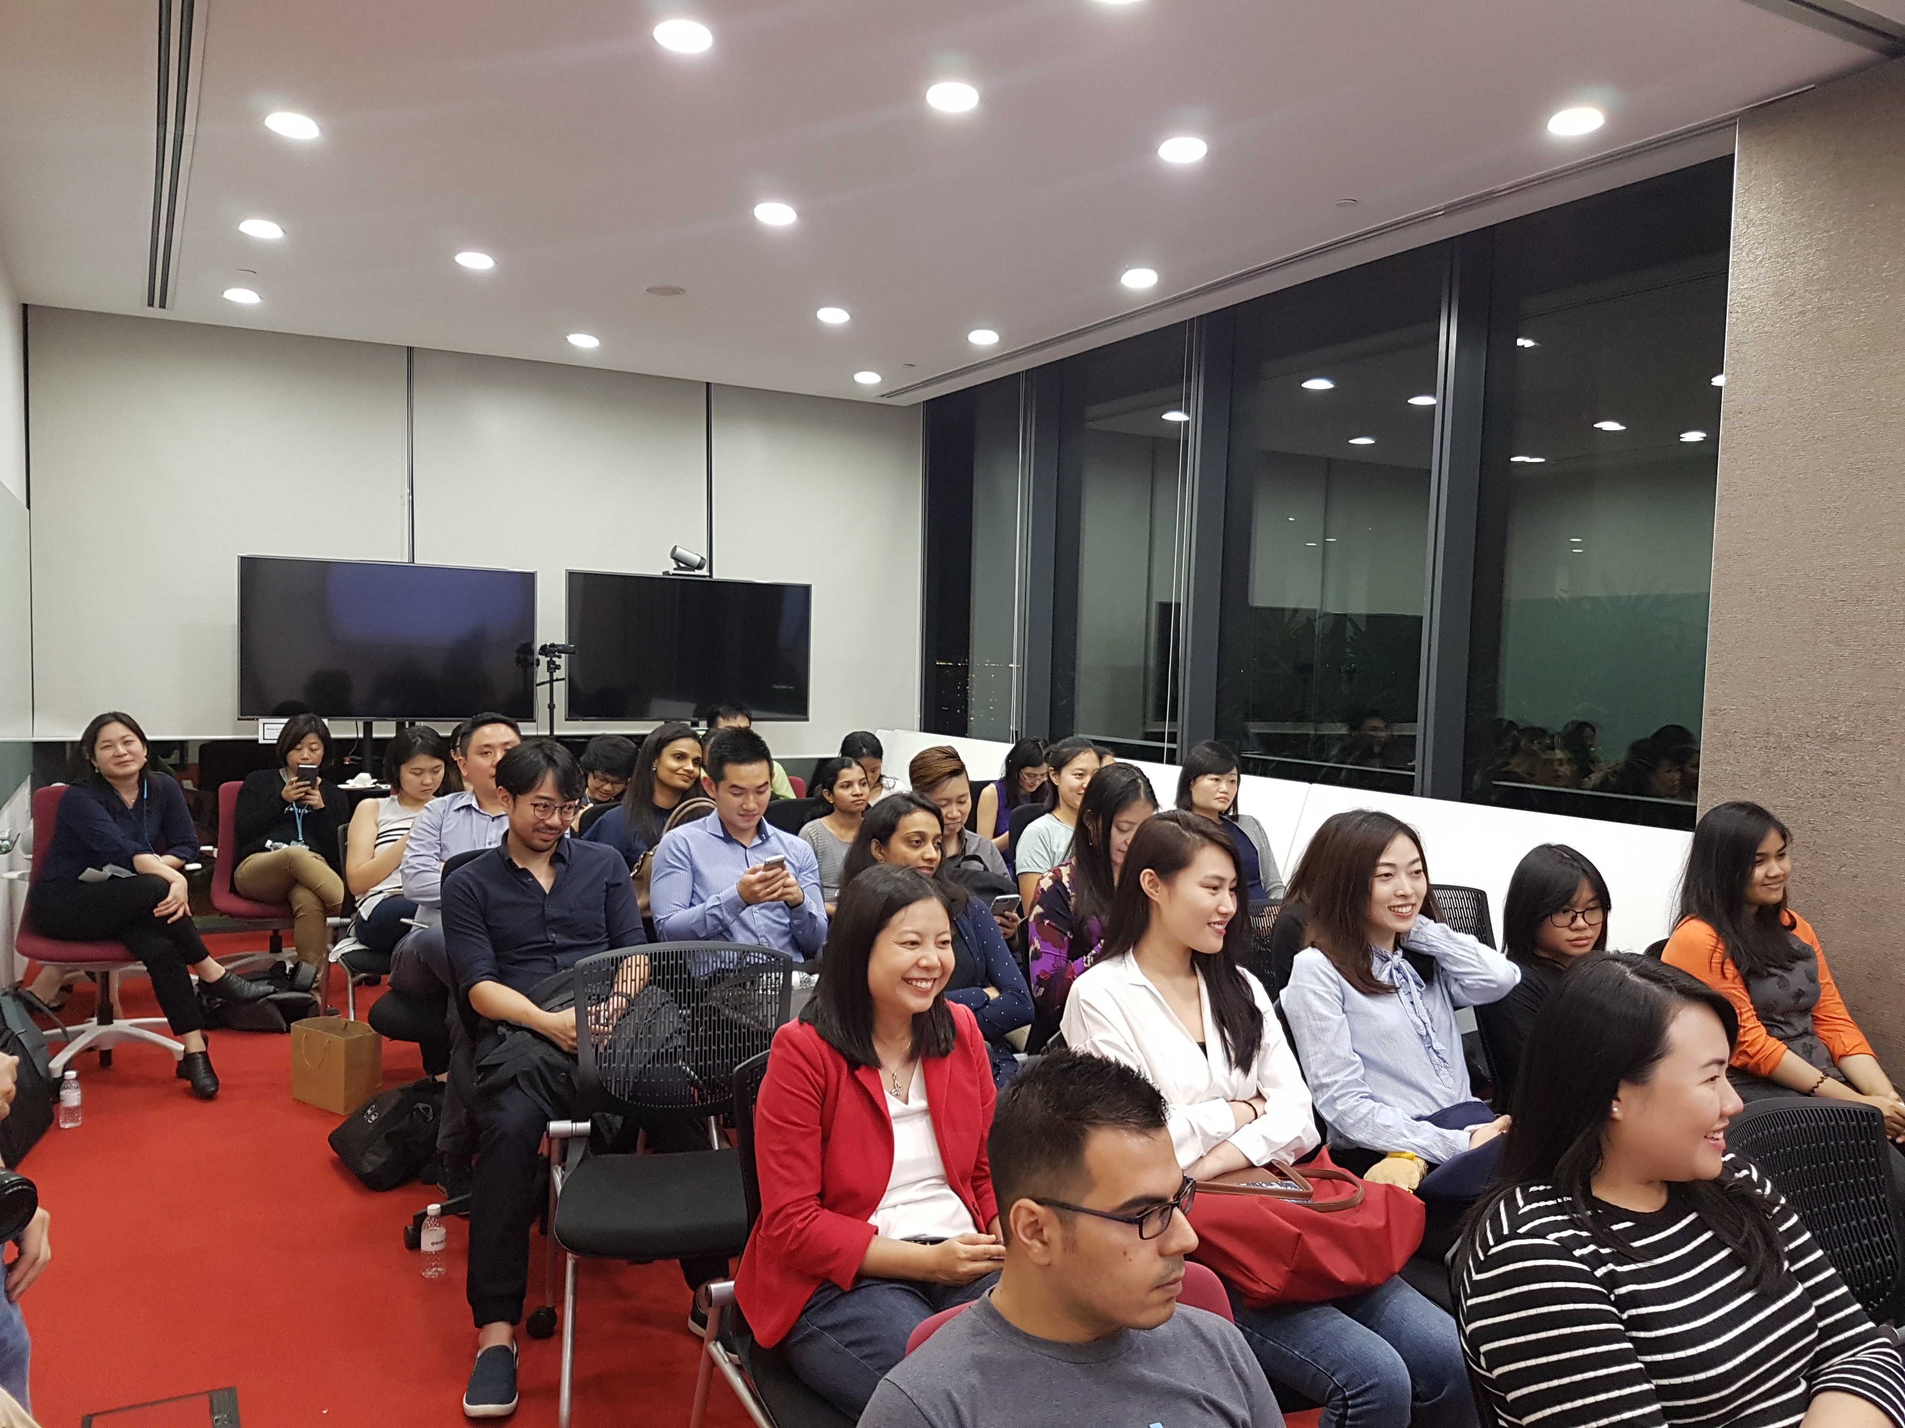

Slide 5


womenwhocode.com/singapore
@WWCodeSingapore
fb.com/wwcodesingapore

Slide 6
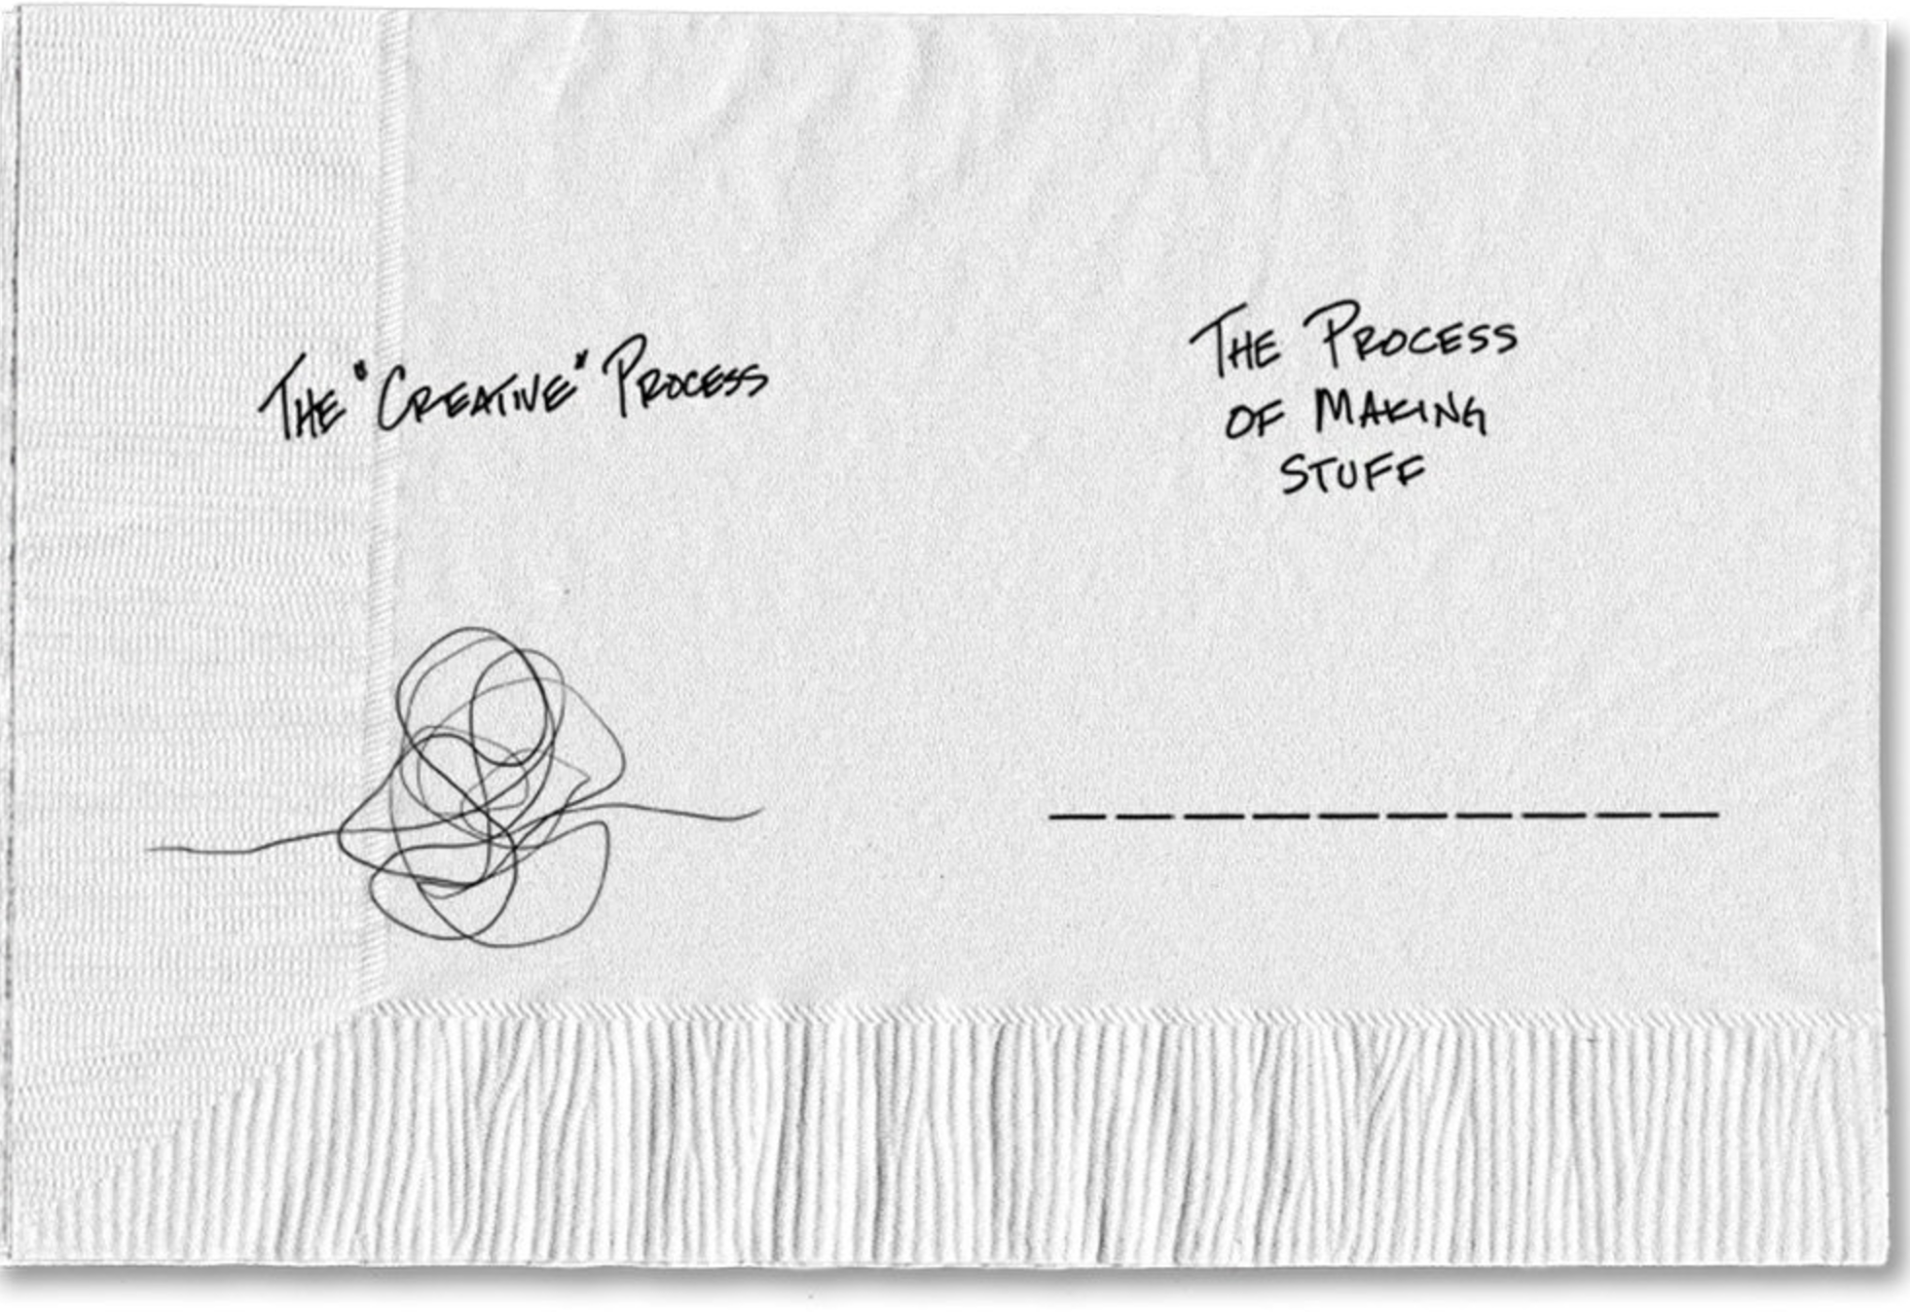

Sketch Guy

Slide 7

artstation.com

Slide 8

Benedict Cumberbatch
Vincent Van Gogh
Muse!!

Slide 9


Slide 10

Invent an Obligation!
================

